Slide 1
22.06.02
CAPSTONE DESIGN in GEOINFORMATIC ENGINEERING
12171218 박민규
12171206 장성준
12171210 정창현

Slide 2
Project Outline
Development Process
Project Results

Slide 3

1. Project Outline
Project Purpose
INHA University Campus AR Navigation
INHA University Campus Buildings(Main Hall ~ 9th Hall)
INHA University Campus AR Navigation Android APP Development
Project Range
Project Goal
Role
박민규 : Data collection, Navigation implementation, Link API
장성준 : AR implementation, UI development
정창현 : DB, Search feature implementation, UI modify

Slide 4
2. Development Process
Development Environment
Name | Version | Use
Android Studio | 2021.2.1 | Application Development
SQLite | 3.38.5 | Database Development
Mapbox Maps API | 9.3.0 | Enable Map use in Andriod APP
Mapbox Navigation API | 0.42.6 | Enable Navigation feature in Andriod APP
Mapbox Unity SDK | 2.1.1 | Enable Map and Navigation feature in Unity
Unity | 19.3.43 | AR function Implementation

Slide 5
2. Development Process
Project Detail Objectives
Function | Detail Function | Contents
AR MAP | 3D Arrow to Navigate | Indicate route with 3D Arrow
 | AR IMOJI | Toilet, Garbage Can, Smoking Area 3D IMOJI
2D Map | Modified 2D Campus Map | Add Entrance and walking routes with Mapbox Studio
Navigation | Shortest Route Algorithm | Use Navigation API
 | Estimated Arrival Time | Use Navigation API
 | GPS Positioning | Realtime GPS Positioning for Navigation
 | Real-Time Route Display | Use Mapbox Built-In Function
 | Distance Calculate | Use Navigation API
Destination Search | Campus Facility DB | Roomname , Shortest Entrance information DB
 | Recent Search List | For user-friendly experience, provide Recent Search List
 | DB Search | Search function with SQLite Query sentence

Slide 6
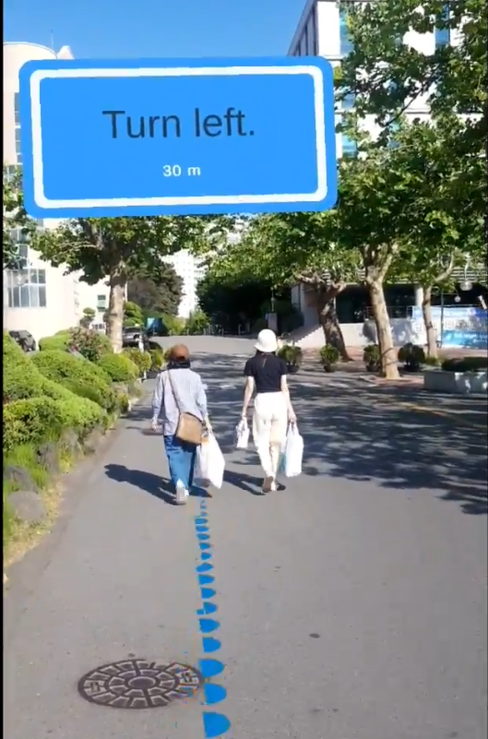
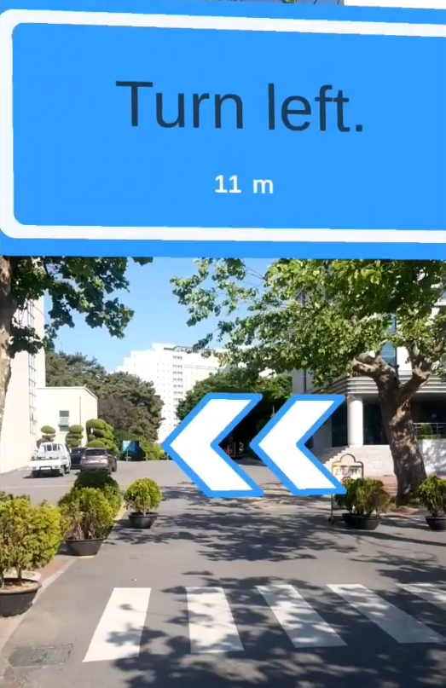
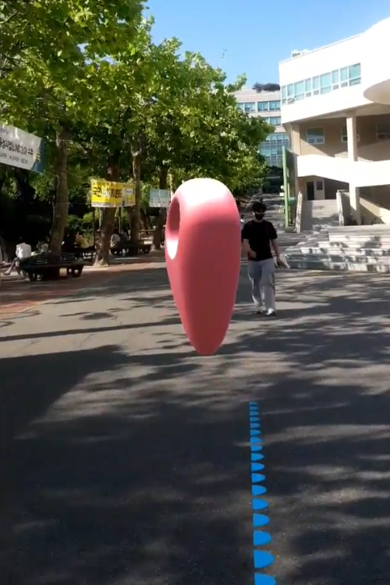
2. Project Activity
AR Navigation
- Unity 3D AR

Slide 7
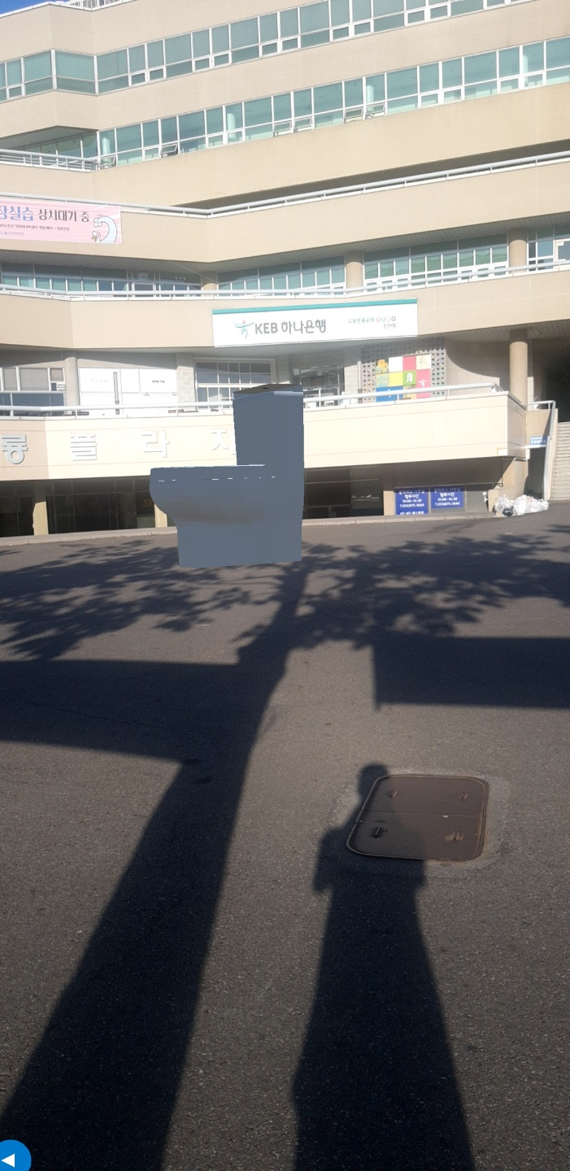

2. Project Activity
AR Navigation
- 3D Imoji

Slide 8
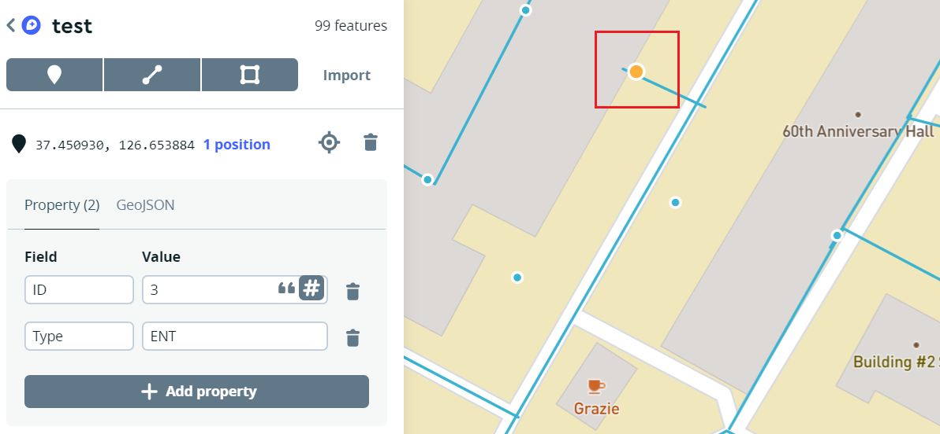
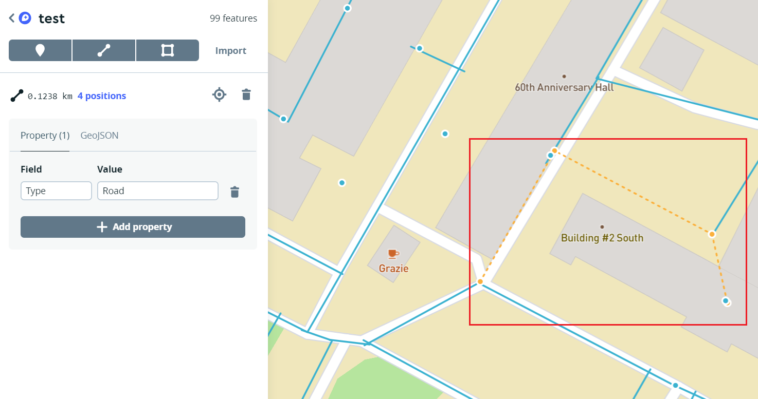
2. Project Activity
2D Map Modify
Using Mapbox studio
Appointed the roads and building entrances in the campus
Add GeoInformatic Features (Coordinates, Type)
< entrance >
<Road>

Slide 9
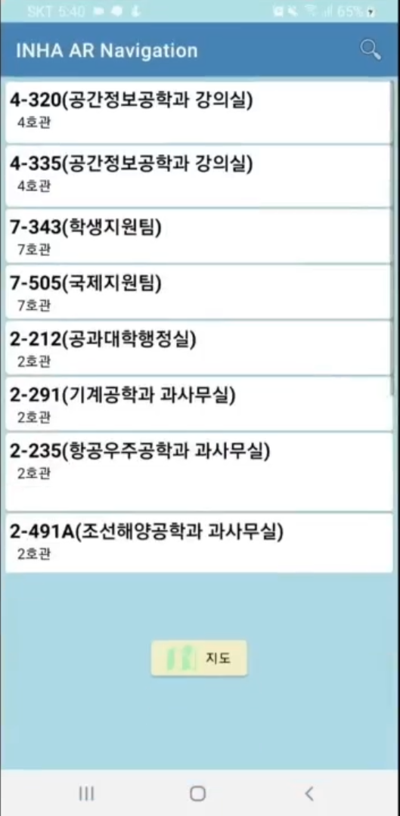
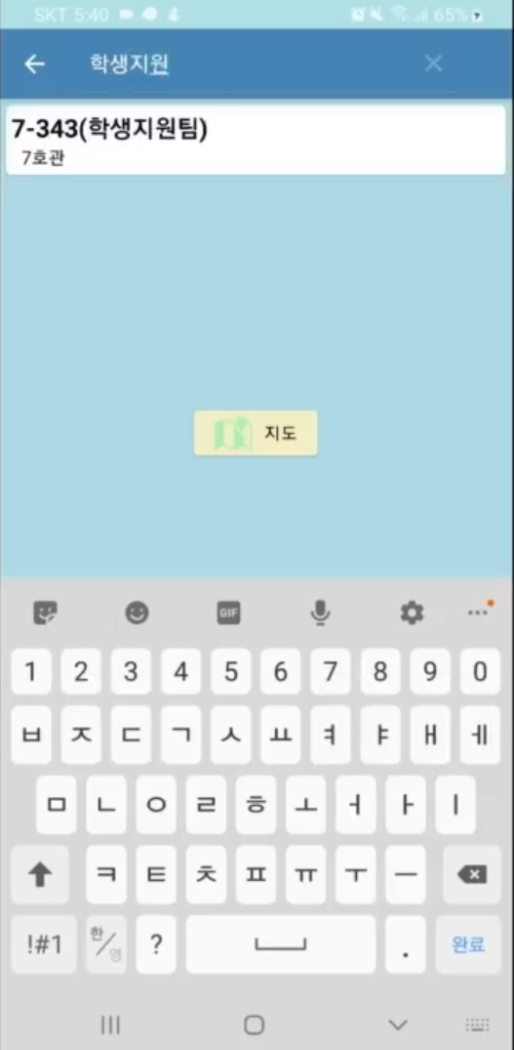
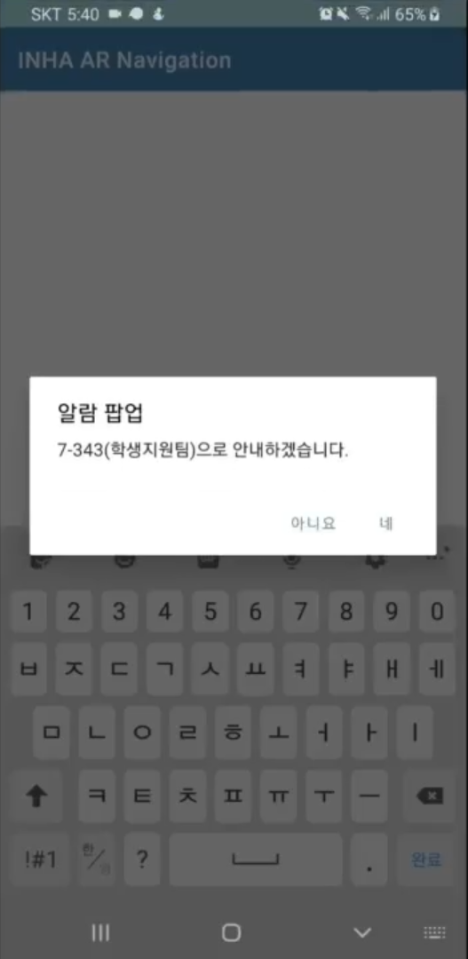
2. Project Activity
DB Search Function
- DB Search Layout / UI

Slide 10
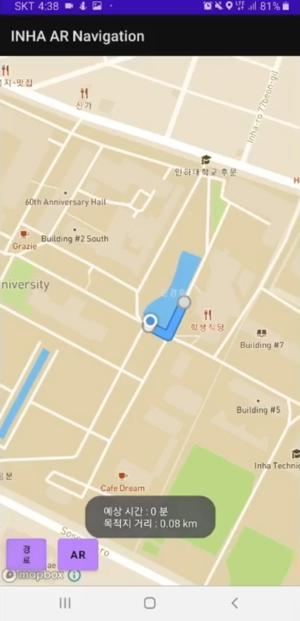
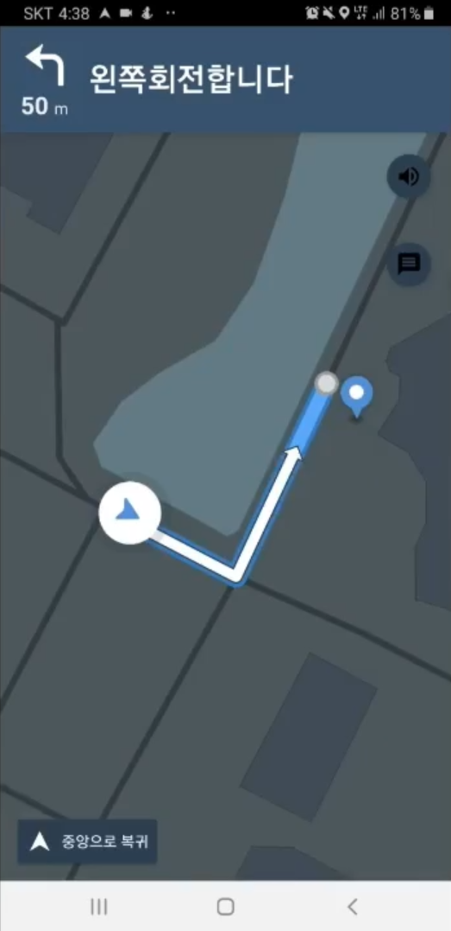
2. Project Activity
2D Navigation
- 2D Direction / Navigation

Slide 11
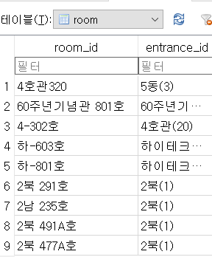
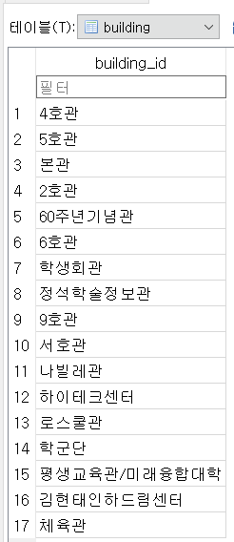
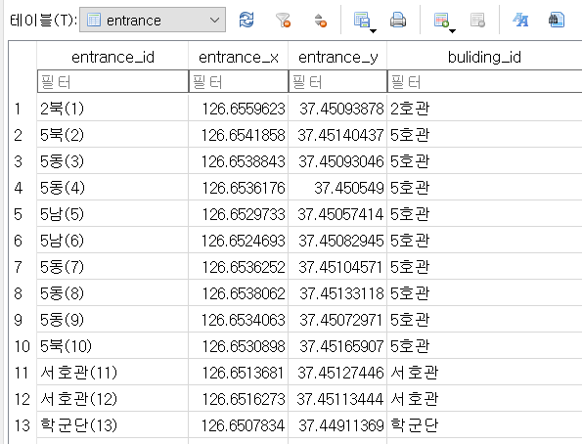
2. Project Activity
DB Search Function
- DB Design
Tool
SQLite
Table list
building : building_id
entrance : entrance_id, entrance_x, entrance_y, building_id
room : room_id, entrance_id
<building>
<entrance>
<room>

Slide 12
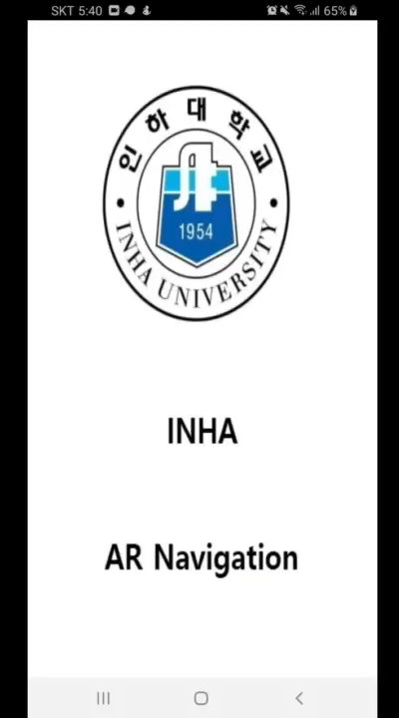
3. Project Results
Demo Video

Slide 13
3. Project Results
Complemantable Points
AR Direction Location Accuracy
2D Map Modify (Sidewalk, Building entrance)
UI Modify
Version Compatiblity

